Slide 1
Urdu cryptography
Group 14 members:
Mustafa bawani (19k-1252)
Haris ganny (19k-1370)

Slide 2
Introduction
Project aims to demonstrate how urdu files can be securely transferred over the network
The solution uses Affine Cipher to encrypt and decrypt files

Slide 3
Motivation
No urdu cryptography available in the market
Need of urdu cryptography algorthm
Innovatory and unique experience to work with UTF-8 (urdu codes)

Slide 4
Affine cipher
Affine cipher is a monoalphabetic substitution cipher
Each letter is mapped to its numeric equivalent using a simple mathematical functon

Slide 5
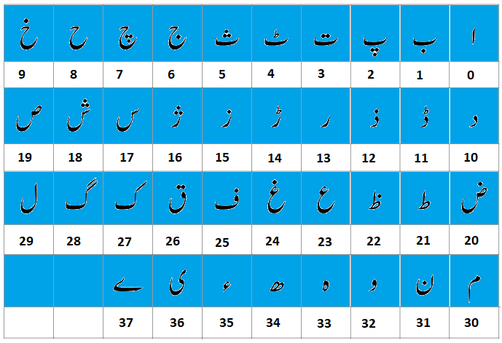

Slide 6
Encryption
The given letter is replaced by looking up to the table by the numeric value obtained from the function
The mathematical function to encrypt a letter is
E=(aX+b) mod m

Slide 7


Encryption (CONTINUED)
Consider we have to encrypt the alphabet پ
E=(5x+3)mod 37
E=(5(2)+3)mod 37
E=13

Slide 8
decryption
An encrypted cipher can be decrypted by inversing the encryption formula
The mathematical function to encrypt a letter is
D=a­­­­­־¹(E-b) mod m

Slide 9
decryption (CONTINUED)
Consider we have to decrypt ر
D=5­­­­־¹(E-3) mod 37
D=23(13-3)mod 37
D=2

Slide 10
Menu flow chart
User enters option
If user enters 1
Call encryption proc
yes
no
If user enters 2
Call decryption proc
yes
no
If user enters 0
Exit program
yes
end

Slide 11
Encryption flowchart
User inputs file name
Open text file
All letters are encrypt
Use table to search the index of the letter
no
yes
Use encryption function to encrypt the letter
Write the encrypted array in file
loop
Replace the letter from the array
end

Slide 12
Decryption flowchart
User inputs file name
Open text file
Compute modular inverse of a
All letters are decrypt
Use table to search the index of the letter
no
yes
Use decrytion function to decrypt the letter
Write the decrypted array in file
loop
Replace the letter from the array
end

Slide 13
Contribution
Mustafa Bawani
Filing
Encryption
Decryption
Haris Ganny
Compute variables
Gcd recursion
Menu
documentation

